Slide 1
MapReduce: Simplified Data Processing on Large Clusters
유연일 민철기

Slide 2
Introduction
MapReduce is a programming model and an associated implementation for processing and generating large data set with parallel, distributed algorithm on cluster, introduced by Google at 2004.
MapReduce designed to process large data by Massively Parallel Processing(MPP) with shared-nothing multi-pc-nodes.

Slide 3
Introduction - Related Works
Hadoop
Apache Hadoop is an open-source software framework which Hadoop’s MapReduce and HDFS components were inspired by Google’s MapReduce and Google File System.
Spark
Apache Spark was developed in response to limitations in the MapReduce cluster computing paradigm, which forces a particular linear dataflow structure on distributed programs. Spark’s resilient distributed dataset(RDD) data structure functions as a working set for distributed programs that offers a restricted form of distributed shared memory
Cloud Dataflow
Google Cloud Dataflow aims to address the performance issues of MapReduce. Holzle, Google’s senior VP of Technical infrastructure, stated that MapReduce performance started to sharply decline when handling multi-petabyte datasets, and Cloud Dataflow apparently offers much better performance on large datasets that Google has largely replaced MapReduce to Cloud Dataflow

Slide 4
Programming Model
The computation takes a set of input key/value pairs, and produces a set of output key/value pairs. The user of the MapReduce library expresses the computation as two functions: Map and Reduce

Slide 5
Programming Model
Map
Map takes an input pair and produces a set of intermediate key/value pairs. The MapReduce library groups together all intermediate values associated with the same intermediate key and passes them to the Reduce Function
Map:(key1, value1) → (key2, value2)

Slide 6
Programming Model
Reduce
Reduce function accepts an intermediate key and a set of values for that key. It merges together those values to form a possibly smaller set of values. The intermediate values are supplied to user’s reduce function via an iterator incase to handle lists of values that are too large to fit in memory.
Reduce:(key2, List of value2) → (key3, value3)

Slide 7
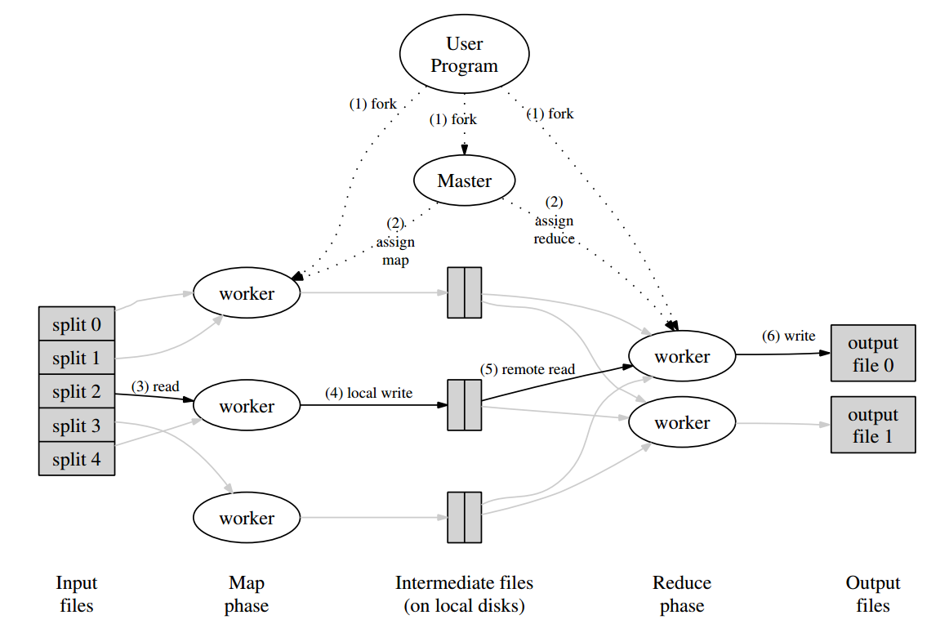
Implementation
MapReduce library in the user program first splits the input file into M pieces. It then starts up many copies of the program on a cluster of machines.

Slide 8
Implementation
2. One of copies of the program is master, and the rest are workers, which assigned by the master.
There are M map tasks and R reduce tasks to assign.
Master picks idle workers and assigns each one a map task or a reduce tasks.

Slide 9
Implementation
3. A worker who is assigned a map task reads the contents of the corresponding input split. It parses key/value pairs out of the input data and passes each pair to the user-defined Map function.
The intermediate key/value pairs produced by the Map function are buffered in memory.

Slide 10
Implementation
4. The buffered pairs are written to local disk, partitioned into R regions by the user-defined partitioning function. The locations of these buffered pairs on the local disk are passed back to the master.
Master is responsible for forwarding these locations to the reduce workers.

Slide 11
Implementation
5. When a reduce worker is notified by the master about these locations, it uses remote procedure calls to read the buffered data from the local disks of the map workers.
Reduce worker then sorts it by the intermediate keys

Slide 12
Implementation
6. The reduce worker iterates over the sorted intermediate data and for each unique intermediate key encountered, it passes the key and the corresponding set of intermediate values to the user’s Reduce function.
The output of the reduce function is appended to a final output file for this reduce partition

Slide 13
Implementation
7. When all map tasks have been completed, master wakes up the user program. At this point, the MapReduce call in the user program returns back to the user code.

Slide 14
Implementation and Refinements
Fault Tolerance
Locality
Task Granularity
Backup Tasks
Skipping Bad Records
...

Slide 15
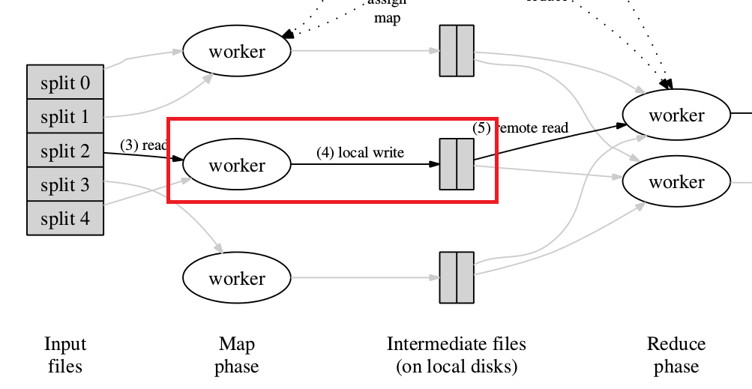
Fault Tolerance
Worker Failure
The master pings every worker periodically.
In-progress map / reduce tasks are re-executed on a failure.
Completed map tasks are re-executed on a failure. (Because their output is stored on the local disk of the failed machine.)
Master Failure
The master can write periodic checkpoints and a new copy can be started from them.
But there is only a single master, its failure is unlikely.

Slide 16
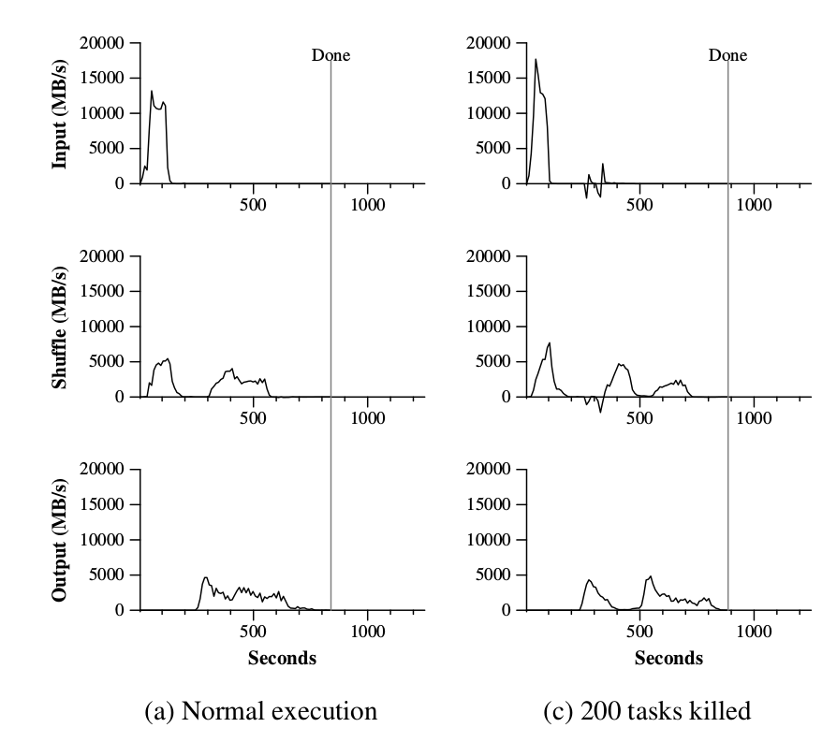
Fault Tolerance

Slide 17
Locality
The master takes the location information of the input files.
It attempts to schedule a map task on a machine that contains a replica of the corresponding input data.
Advantage
Machines can read input at local disk speed.
consumes no network bandwidth.

Slide 18
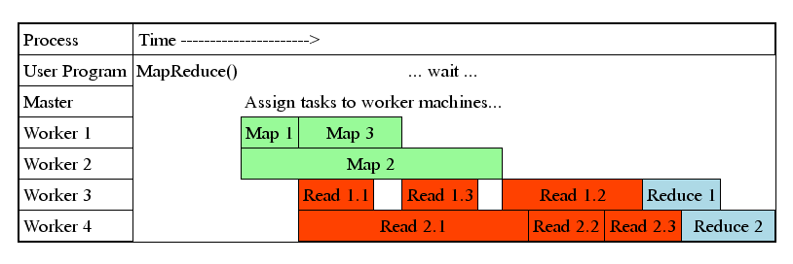
Task Granularity
Ideally, number of map / reduce tasks should be much larger than number of workers (fine granularity tasks)
Advantage
Minimizes fault recovery time.
Improves dynamic load balancing.
And pipeline...

Slide 19
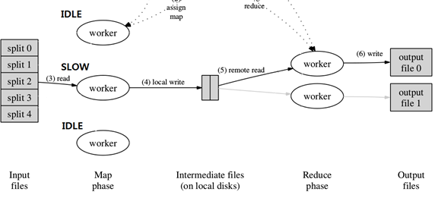
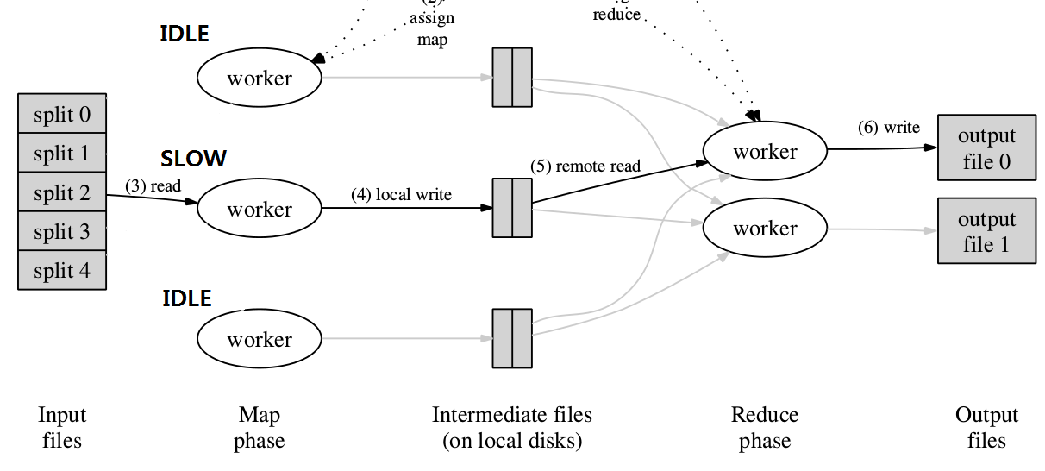
Backup Tasks
Slow workers(bad disks, bugs …) lengthen completion time.
Copies of tasks and redundant execution near of end phase.

Slide 20
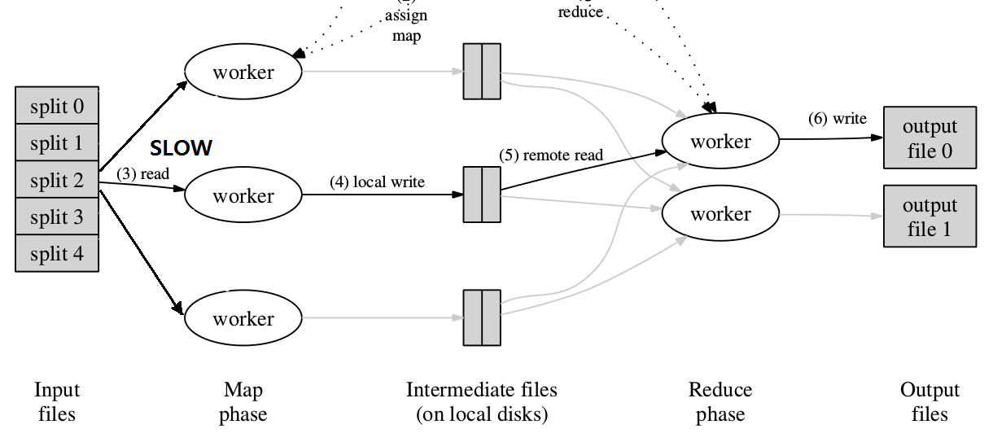
Backup Tasks
Slow workers(bad disks, bugs …) lengthen completion time.
Copies of tasks and redundant execution near of end phase.

Slide 21
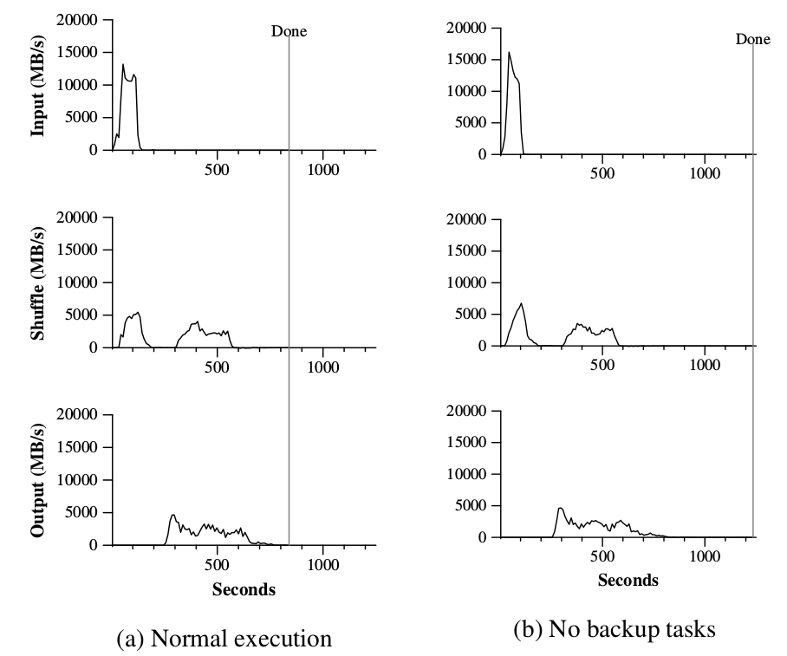
Backup Tasks

Slide 22
Skipping Bad Records
These records can be skipped.
Records resulting bugs in library for which source code is unavailable.
A few records which is acceptable to ignore in large statistical analysis.
When the master has seen more than one failure on a particular record, it indicates that the record should be skipped in next re-execution.

Slide 23
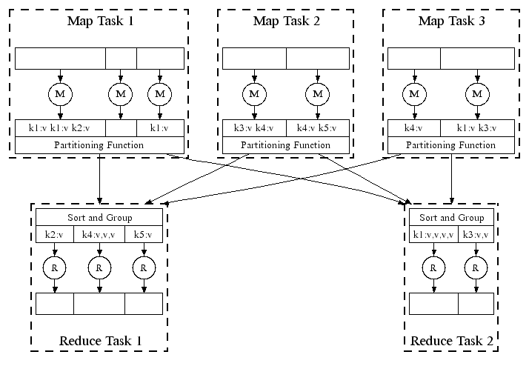
Partitioning Function
Data is partitioned by a partitioning function
e.g. hash(key) mod R
Combiner Function
Combines data before it is sent over the network.
e.g. <the, 1> X 5 ---> <the,5> in word count.
Executed on each machine that performs a map task.
Ordering Guarantees
Intermediate key/value pairs are processed in increasing key order.

Slide 24
Input and Output Types
Provides support for reading input data in several formats.
e.g. Read a file and generate key value pair as <number of line, contents of the line>
e.g. Read data from database or mapped memory by reader interface
Side-effects
Produces auxiliary files as additional outputs from map / reduce operators.

Slide 25
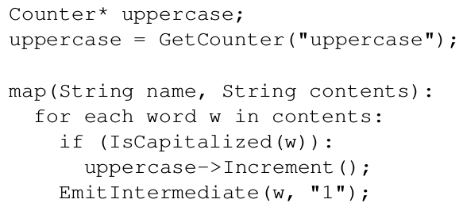
Counters
User code creates a named counter object and increments in map / reduce function.
Periodically propagated to the master.
Useful for sanity checking the behavior of MapReduce operations.

Slide 26
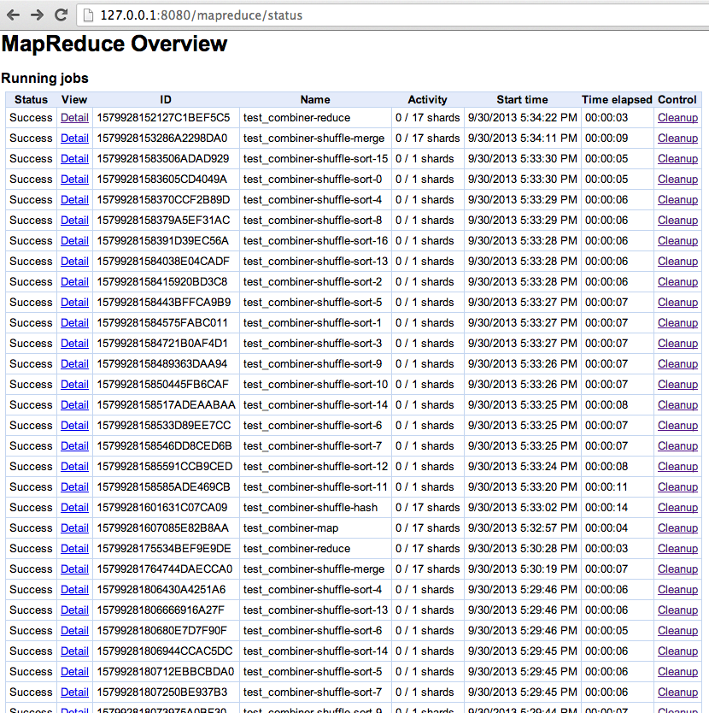
Local Execution
Executes all of the work on the local machine.
For debugging, profiling and small-scale testing.
Status Information
The master runs an internal HTTP server and shows status pages.

Slide 27
Summary
MapReduce is a programming model and an associated implementation for processing and generating large data set with parallel
A large variety of problems are easily expreeible as MapReduce computations.
There are many refinements but MapReduce is easy to use since it hides the details.

